Slide 1
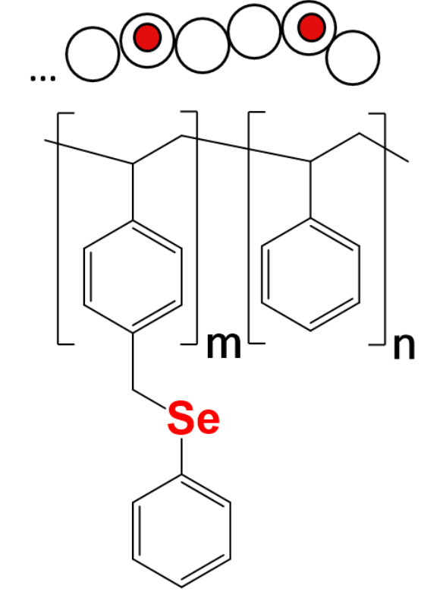













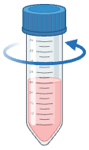
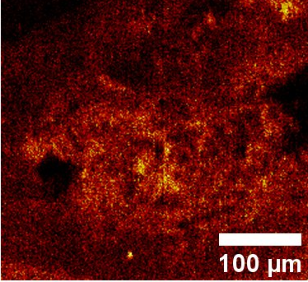
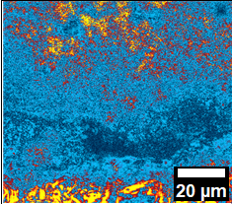
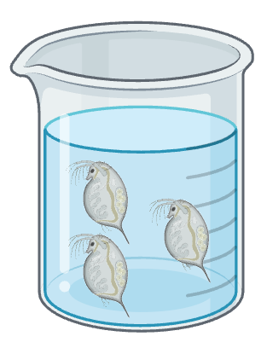
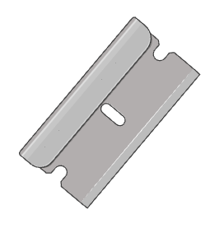

cryomilling
size separation
localization using
O-PTIR and ToF-SIMS
histological slices using cryotome
expose
D. magna

Slide 2

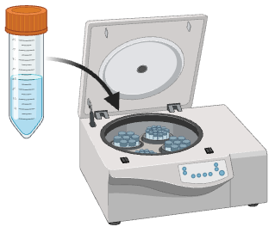
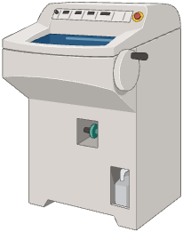
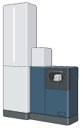
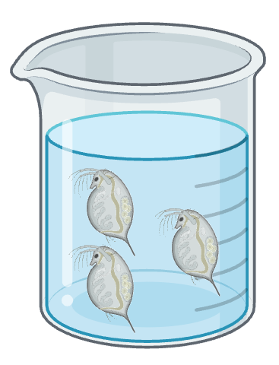
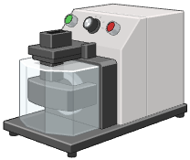

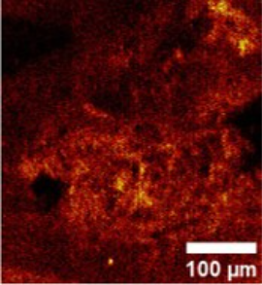
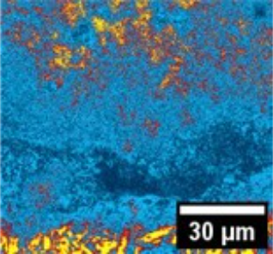

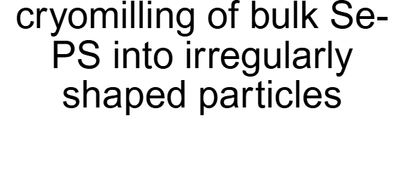
size separation
cyrotome
exposed D. magna
expose D. magna to Se-PS particles
selenium and polymer detection using O-PTIR and TOF-SIMS
synthesis
of Se-PS

Slide 3

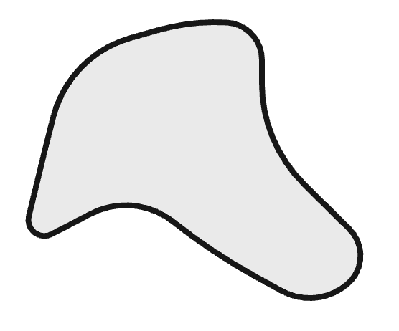

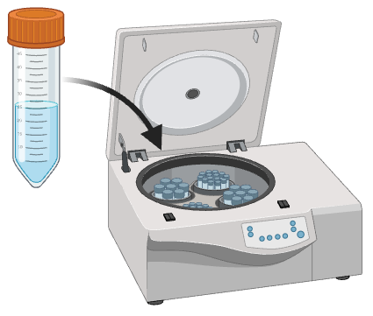
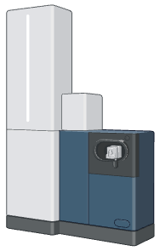
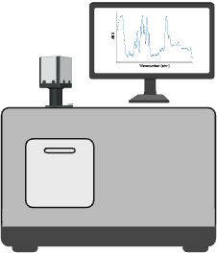
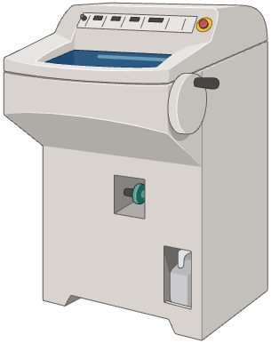

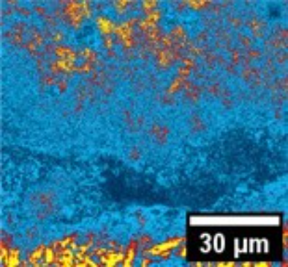
synthesis
of Se-PS
cryomilling of bulk Se-PS into irregularly shaped particles
centrifugation for size separation
selenium and polymer detection using O-PTIR and TOF-SIMS
obtaining histological slices using cryotome
expose D. magna to Se-PS particles

Slide 4
Get the BioRender Add-in for PowerPoint
Our integration allows you to unlock the power of BioRender, right inside PowerPoint:
  Export your BioRender presentation as an editable .PPTX file.
  Edit BioRender figures without leaving your PowerPoint slides.
  Sync updates from BioRender with just one click.
  Effortlessly manage sharing and permissions with your team.
  Access your entire BioRender library at your fingertips.
  Need a transparent background? Toggle it on or off, anytime.
BioRender for PowerPoint is hosted safely and securely in the Microsoft AppSource.
This presentation was created in BioRender
To access the original source of this presentation, visit:
https://app.biorender.com/illustrations/69e650e5b06e265f690efbfd
Sign up for your own BioRender account at www.biorender.com
Get the add-in now:
https://appsource.microsoft.com/en-us/product/office/wa200006038?src=product&mktcmpid=pptx_export

